Slide 1
Hermes Control Center
From first download to first delivery
A clear operator playbook for installation, blueprint-driven project creation, deployment, live runs, approvals, learnings, and outbound delivery across Hermes-managed workflows.
Web control plane plus local Hermes runtime
Operator starting points
Download, pair, build, deploy, and operate from one surface.
Hermes Control Center - Operator Guide

Slide 2
Step 1
Download and installer paths
Hermes supports public downloads, guided pairing, and portable runtime workflows across Windows WSL, Linux, and macOS.
Public downloads: ideal when the installer is needed before sign-in or before workspace creation.
Local Runtime pairing: ideal when the operator is already signed in and wants approval-based bootstrap.
Portable runtime bundles: ideal for removable-media or field-ops deployment patterns.
Supported systems and installer modes
Windows WSL, Linux, macOS, and portable runtime options.
Hermes Control Center - Operator Guide

Slide 3
Step 2
Workspace account setup
The first operator registers the workspace, verifies email, creates a pairing session, and installs the local Hermes runtime with a one-time code and LLM provider settings.
Create account
Pair local runtime
Workspace name, operator identity, timezone, and verification.
Create a session, paste the code, enter LLM values, approve the machine, and keep the node online.
Hermes Control Center - Operator Guide

Slide 4
Step 3
Local runtime installation
The local Hermes runtime is paired to the workspace and receives the LLM provider values it needs during installation.
Create a pairing session in Local Runtime for the correct OS, architecture, and install mode.
Run the installer locally, paste the pairing code, and enter the runtime API key, base URL, and primary model.
Approve the machine so the node can register and stay online for deployment pickup.
Local runtime installation
Pair once, enter LLM values, approve the node, and keep the runtime online.
Hermes Control Center - Operator Guide

Slide 5
Step 4
Project Builder blueprint
For first-time teams, the main project creation flow starts in Project Builder. The blueprint description becomes the source for the generated project and operating surfaces.
Describe the business workflow, expected outcomes, review rules, and delivery intent in plain English.
Use Project Builder as the primary creation surface instead of hand-building each page first.
Let Hermes generate the initial project shape from the blueprint.
Project Builder blueprint workflow
Hermes uses the blueprint description to generate the first operating structure.
Hermes Control Center - Operator Guide

Slide 6
Step 5
Blueprint verification
A healthy blueprint should create the project and populate active agents, topology links, prompt drafts, and schedule before the project ever reaches deployment.
Confirm the project record itself was generated and is selectable across the control plane.
Check Agents for active roles and bound profile names.
Check Agent Topology for reviewer, supervisor, and worker relationships.
Check Prompt Editor for generated prompt drafts and Settings for schedule.
Blueprint output verification
Projects, agents, topology, prompts, and schedule should all be visible.
Hermes Control Center - Operator Guide

Slide 7
Step 6
Deployment to a live node
Deployment converts the generated project into a runtime-ready package and binds it to an online node.
Select the generated project and an online node in Deployments, then publish.
Wait for Applied before using Run now.
If the package is not Applied yet, the run may start without the correct local profiles.
Hermes Control Center - Operator Guide
Deployment and run workflow
Publish, apply, run, and monitor queue-to-completion task flow.

Slide 8
Step 7
First run operations
A run normally starts with a supervisor coordination task. More tasks appear when the supervisor creates work for workers and reviewers.
Use Run now to create a manual execution wave.
Watch for the first task to move from Queued to Claimed to In Progress to Completed.
If the run ends with only one task and no outcomes, inspect prompts, node health, or local execution health.
Hermes Control Center - Operator Guide
Run result expectations
A good run expands, completes, and produces visible business artifacts.

Slide 9
Step 8
Outcome verification
Use the outcome pages to confirm that the run created meaningful operational results instead of only green task badges.
Leads: discovered companies, websites, fit scores, and status.
Contacts: imported or added contacts for downstream email delivery.
Email Drafts: review-ready content for approvals.
Deliveries and Learnings: dispatchable outputs and reusable operator memory.
Governance and outcomes
Approve drafts, dispatch deliveries, and promote useful learnings.
Hermes Control Center - Operator Guide

Slide 10
Step 9
Review, learnings, and delivery
After a successful run, operators review drafts, approve learnings, and dispatch outbound delivery from the same control plane.
Use Approvals to review draft quality and request regeneration when needed.
Use Learnings to preserve reusable operator memory for the next deployment cycle.
Use Deliveries to send Email and Telegram outputs and verify sent or failed status.
Governance and delivery
Approve drafts, promote learnings, and dispatch live outputs.
Hermes Control Center - Operator Guide

Slide 11
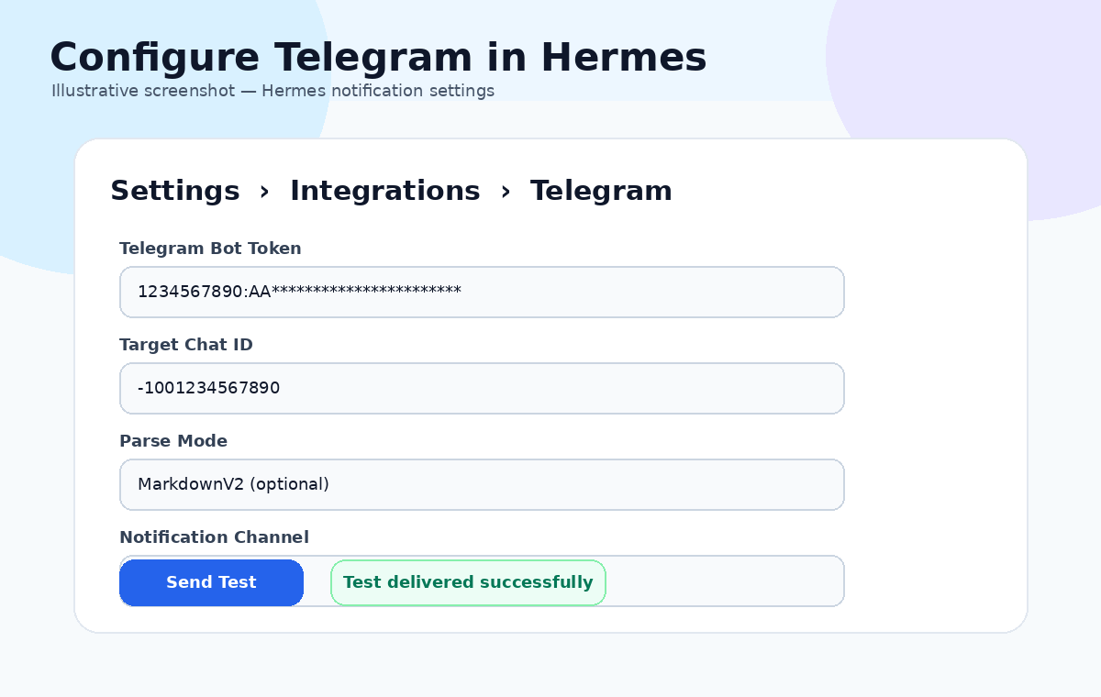
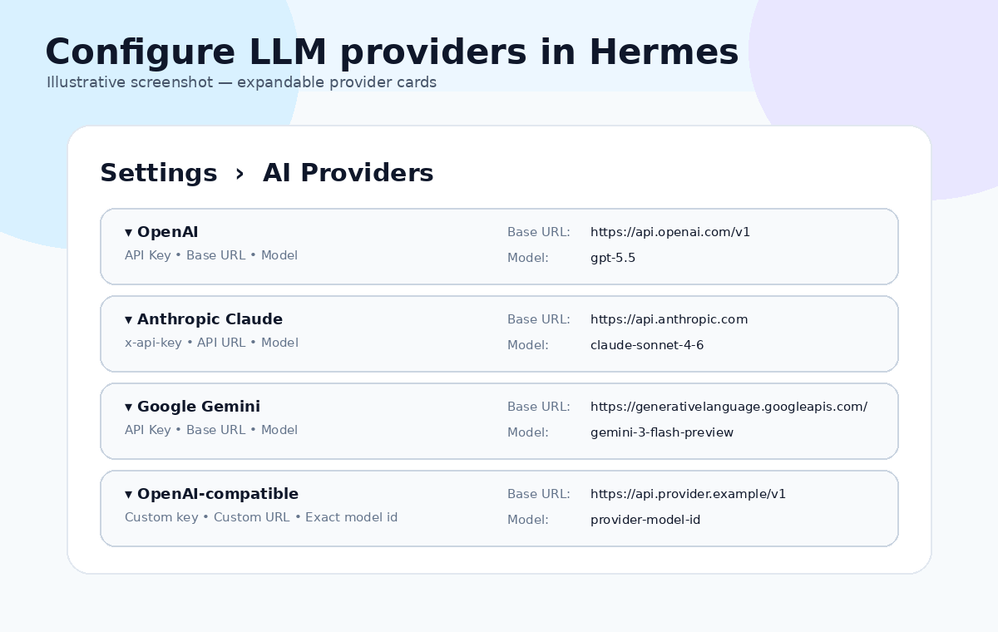
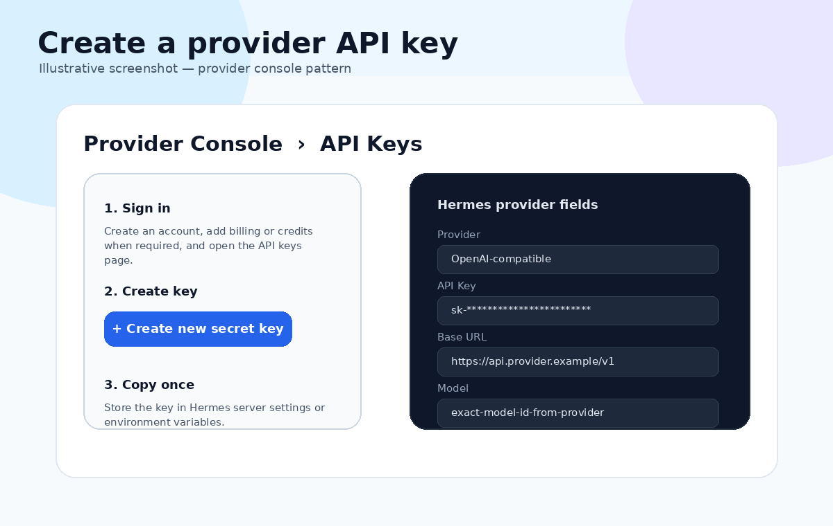
Step 10
Settings, Telegram, and LLM credentials
Hermes separates runtime and delivery setup so first-time operators know exactly where each value belongs.
Provider cards
OpenAI, Azure OpenAI, Claude, Gemini, Groq, Mistral, DeepSeek, xAI, OpenRouter, Ollama.
Telegram setup in Settings
Provider console examples
Store the bot token, validate the target, and confirm chat details.
See where API key, base URL, and model values come from.
During Local Runtime installation, enter the provider API key, base URL, and primary model used by the Hermes runtime.
In Settings, save TELEGRAM_BOT_TOKEN and test the Telegram target before dispatching live deliveries.
Hermes Control Center - Operator Guide

Slide 12
Hermes Control Center
Ready for the first controlled production run
Open the operator guide for the full first-time flow.
Use the setup guide when you need Telegram or LLM credentials.
Use Local Runtime to pair a machine and keep Hermes execution local.
Use Project Builder, Deployments, Runs, Approvals, Learnings, and Deliveries as one control plane.
Download guide and start installation
Control plane outcome surfaces
Leads, drafts, approvals, deliveries, and learnings in one place.
https://hermes.stillherecare.com/getting-started
Hermes Control Center - Promotional Operator Deck

